Slide 1




Crowd Capital Platform

Slide 2

CONTENTS
INTRODUCTION
ABSTRACT
EXISTING SYSTEM
PROPOSED SYSTEM AND ITS ADVANTAGES
APPLICATIONS
PROJECT REQUIRMENTS
OUTPUT SCREENS
CONCLUSION
REFERENCE
CROWD CAPITAL

Slide 3

Introduction:
In the era of digital connectivity, Crowd Capital Platforms have emerged as powerful tools for individuals and organizations to raise funds for their projects, ventures, or causes.
These platforms offer a space where creators can showcase their ideas and connect with a community of potential backers willing to support them financially.
This article presents the development of a Crowd Capital Platform using PHP and MySQL, aiming to provide a robust and user-friendly solution for both project creators and backers.

Slide 4

Abstract:
The proposed Crowd Capital Platform leverages PHP and MySQL technologies to create a dynamic and interactive environment where project creators can pitch their ideas and backers can contribute financially to bring those ideas to life.
The system will facilitate seamless project creation, management, and funding while ensuring security and reliability throughout the process.

Slide 5

Existing System and its limitation:
Currently, various Crowd Capital Platforms exist, each with its own set of features and limitations. However, many of these platforms may lack certain functionalities or may not fully address the needs of project creators and backers.
Common issues include high transaction fees
Limited customization options
lack of transparency in fund distribution.

Slide 6


Proposed System:
The proposed Crowd Capital Platform aims to overcome the shortcomings of existing systems by providing a comprehensive solution with the following features:
User-friendly project creation and management interface
Secure payment processing
Transparent fund distribution
Customizable project pages
Community engagement tools
Robust search and discovery functionality

Slide 7

Advantages of Proposed System:
1.User-Friendly Interface.
2. Transparent Fund Distribution.
3. Customization Options.
4. Community Engagement.
5. Robust Search Functionality.

Slide 8



Applications:
The Crowd Capital Platform can be utilized for various purposes including:
Funding creative projects (art, music, film)
Supporting entrepreneurial ventures
Raising funds for charitable causes
Financing research and development initiatives

Slide 9
Project Requirements:
HARDWARE
Server capable of running PHP and MySQL
Internet connectivity for online accessibility
SOFTWARE
PHP development environment (such as XAMPP, WAMP, or similar)
Web browser for user interaction
MySQL database management system

Slide 10
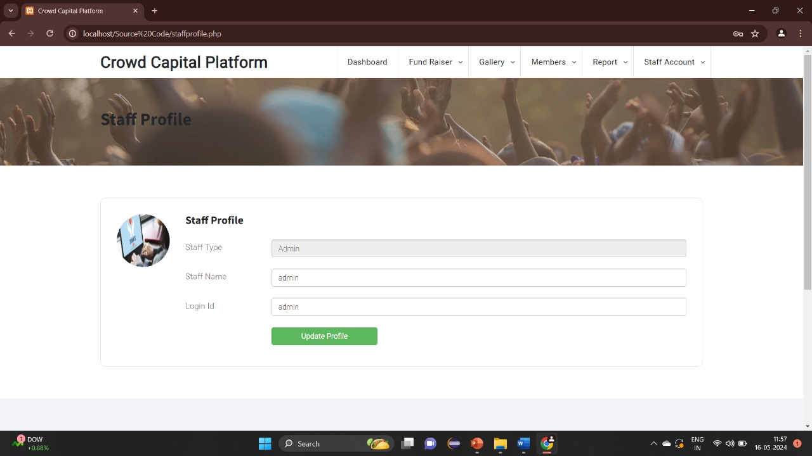
STAFF PROFILE

Slide 11
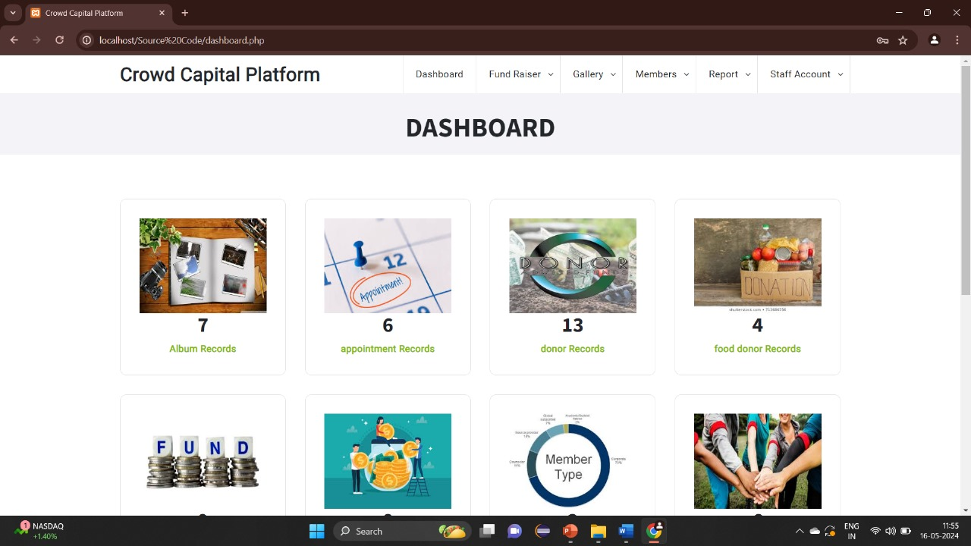
DASHBOARD

Slide 12
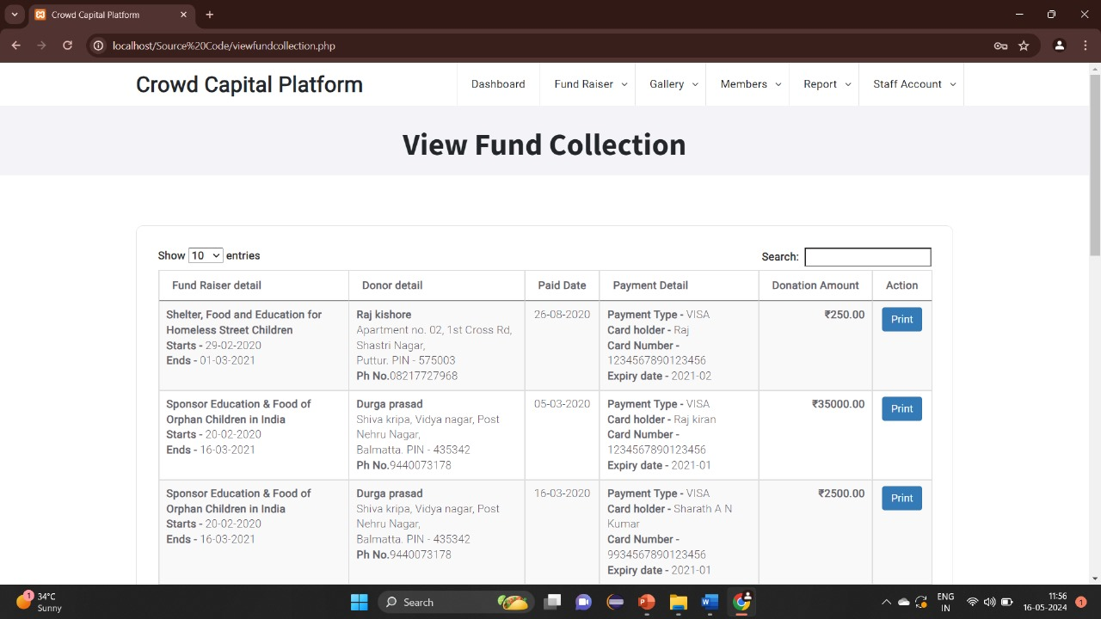
View Fund Collection

Slide 13

Conclusion:
In conclusion, the development of a Crowd Capital Platform using PHP and MySQL presents an opportunity to create a robust and scalable solution for facilitating crowdfunding campaigns.
By addressing the limitations of existing systems and incorporating user-centric features, the platform aims to empower creators and backers alike, fostering a vibrant ecosystem of innovation and collaboration.

Slide 14



References:
1. Crowdfunding: A Literature Review and Research Directions: This paper explores crowdfunding in the context of public policy funding, highlighting various campaign strategies and their effectiveness.
2. Determinants of Crowdfunding Success: Kaartemo (2017) identifies four main determinants of crowdfunding success: project characteristics, creator attributes, backer motivations, and platform features.
3. Analysis of Success Factors in Crowdfunding Projects: This research identifies significant variables affecting crowdfunding success, including location, experience, human capital, and gender.

Slide 15


